Slide 1
MARVIN: A 3D Printed, Internet Enabled Product Design and Staff Development Project
18/01/2019

Slide 2
Abstract
A staff and curriculum development project instigated within the context of educational professional development
I was requested to write two 5CP masters degree modules based on my Internet of Things IoT research
The modules focus on the design and build of a 3D Printed, Internet enable product destined for the IoT marketplace
Notes:
an example of the use of mobile technologies integrated into a staff and curriculum development project instigated within the context of educational professional development

Slide 3
Staff Development
Common complaints
This is a waste of my time, I’ve been over this subject several times before and do not need to do it again
My time would be better spent keeping up with advances in my own discipline
But what about the need to expand into new areas and new skillsets
Notes:
As head of faculty I would respond with Sharing Good Practice and helping others less experienced
As institution I would respond with keeping up to date being part of job description
I have encountered these frustrations in my own career development so do understand them - but also see the points from management and institution as well

Slide 4
Continuing Professional Development
We have a need for a highly skilled workforce
IoT is creating lots of new high tech jobs
Manual and low skilled jobs are in recession
This means
It’s critical to keep higher education learning and teaching relevant to developing learners that can take advantage of this highly skilled jobs market place
Notes:
We are in need of an increasingly highly skilled workforce with lots of high tech jobs being created in areas such as the IoT while manual and low skilled jobs are in long term, and possibly permanent recession, due in no small part to automation, robotics and the proliferation of information and communication technologies.

Slide 5
Lifelong Learning
It is my view that life-long learning is one of the key elements that make for a happier life here on Earth!
The National Institute of Adult Continuing Education (NIACE) ((NIACE), 2019) amongst others; see the work of (McNair, 2019) and a summary of “The Impact of Lifelong Learning on Happiness and Well-being” (Sabates & Hammond, 2019).
Just ‘sweet sentiment’?

Slide 6
Introduction
Mobile Technologies in Education - a different take
We might think of Padlet, Kahoot, Slack, Trello, Asana
This project places the design of the Mobile Technology at the centre of the learning experience
Notes:
Real-time Quizzes, Questionnaires

Slide 7
The Project
Started off as a bit of a joke
Rubber purple hair etc.
But we should practice what we preach
IoT job opportunities for my students
Very little time to implement interdisciplinary team project 26 hours total allocation
Time allocations to other staff (AQF +1 etc.)

Slide 8
The Plan
To execute the project and assignments within the interdisciplinary staff team prior to delivery of the module to students
Specifics of soldering, electronic design, programming and coding decisions are beyond the scope of this paper (files shared on GitHub)
So to the design decisions regarding execution of the assignments.

Slide 9
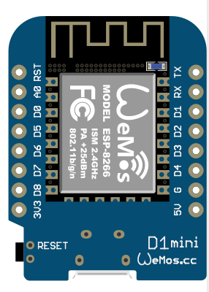
The D1 Mini - or at least one version of it!

Slide 10
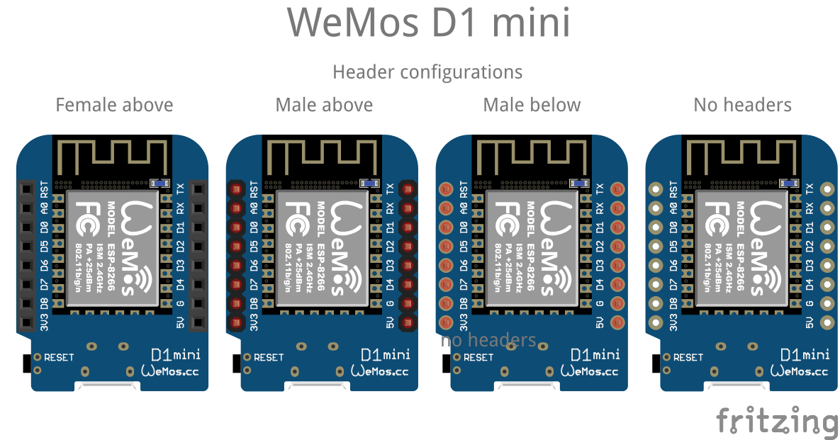
Versions
Notes:
There are in fact new versions without the metal chip casing now

Slide 11
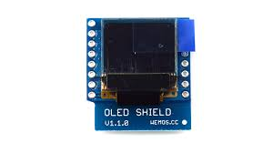
Wemos OLED Shield

Slide 12
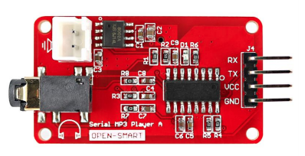
OPEN-SMART mp3 Player

Slide 13
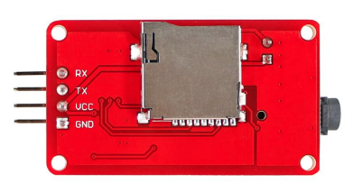
With Micro SD Card Reader

Slide 14
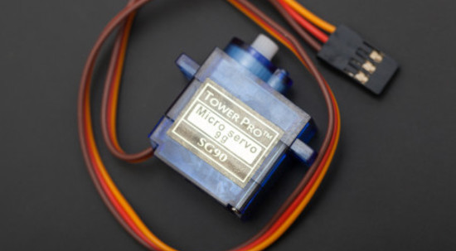
Servo for Dancing

Slide 15
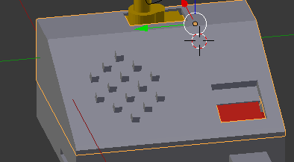
Closed Base Blender Image

Slide 16
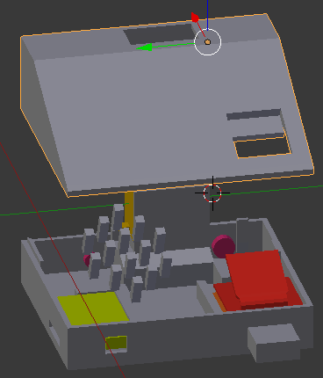
Open Base Blender Image

Slide 17
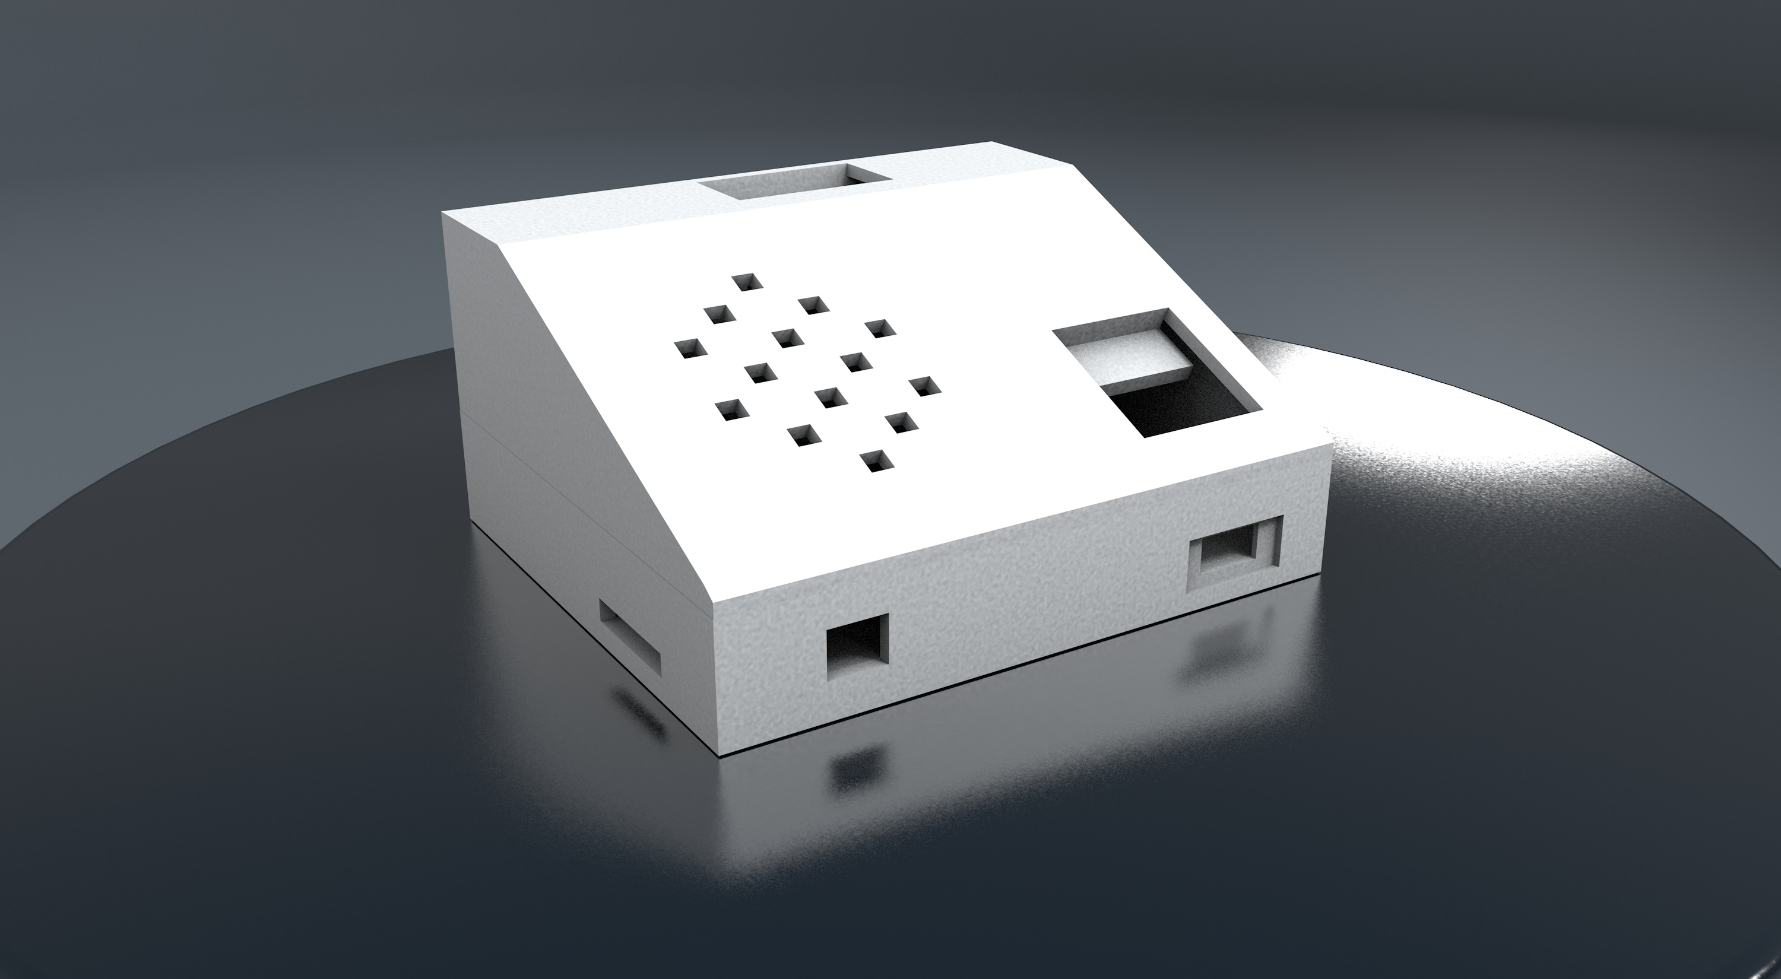
Finished Base Rendered Image

Slide 18
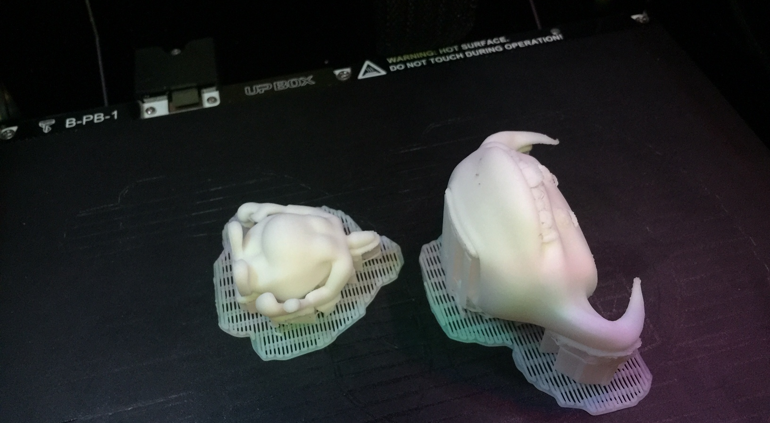

Slide 20
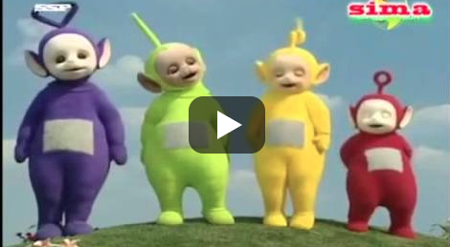

Slide 21
Conclusion
We did not achieve everything we set out to do, but we did achieve 95% of the main plan in very little time indeed, and we enjoyed it!
The message is clear
Lifelong learning is one of the keys to a fruitful life, and a fruitful life is one of the keys to happiness here on this Earth! ☺

Slide 22
Bibliography
(NIACE), National Institute of Adult Continuing Education. (2019). Retrieved 12th January, 2019, from https://http://www.local.gov.uk/our-support/research/partner-organisations/national-institute-adult-continuing-education-niace
Arduino. (2019). Retrieved 12th January, 2019, from http://www.arduino.cc/
Asana. (2019). from https://asana.com/
Blender. (2019). Retrieved 12th January, 2019, from https://http://www.blender.org/
Cycling 74. (2019). Max. Retrieved 12th January, 2019, from http://cycling74.com/
Framework, Australian Qualifications. (2019). Retrieved 12th January, 2019, from https://http://www.aqf.edu.au/
GitHub. (2019). Retrieved January 12th, 2019, from https://github.com/
Kahoot. (2019). from https://kahoot.it/
McNair, Professor Stephen. (2019). Retrieved January 12th, 2019, from http://www.stephenmcnair.uk/index.php/adult-education/
Narnia. (2019). Retrieved January 12th, 2019, from http://www.narnia.com/us/
Padlet. (2019). from https://padlet.com/
Pictures, Touchstone. (2019). Retrieved January 12th, 2019, from https://http://www.youtube.com/watch?v=zVoYDLhmS0g
Sabates, Ricardo, & Hammond, Cathie. (2019). The Impact of Lifelong Learning on Happiness and Well-being.
Slack. (2019). from https://slack.com/
Smart, Open. (2019). Retrieved 12th January, 2019, from https://open-smart.aliexpress.com/store/1199788
Trello. (2019). from https://trello.com/
WEMOS.). Retrieved 12th January, 2019, from https://http://www.wemos.cc/

Slide 23
Thank-you for listening

